Slide 1
Multi-Agent Reinforcement Learning:
A Selective Overview and A Decentralized Solution
Kaiqing Zhang
Amazon AI Labs Intern
Mentor: Sahika Genc
RL Reading Group
2019.07.26

Slide 2
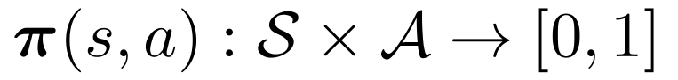
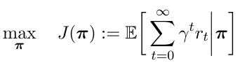
Reinforcement Learning (RL)
Reinforcement Learning: solving Markov decision processes/optimal control problem without knowing the model
(Stationary) policy:
Goal: maximize accumulated/time-average reward
Algorithms:
Critic-only: e.g., Q-learning, SARSA, DQN, DDQN
Actor-only: e.g., policy gradient, PPO, TRPO
Actor-critic enjoys both advantages
Source: Reinforcement learning Lecture Notes, David Silver, 2016

Slide 3
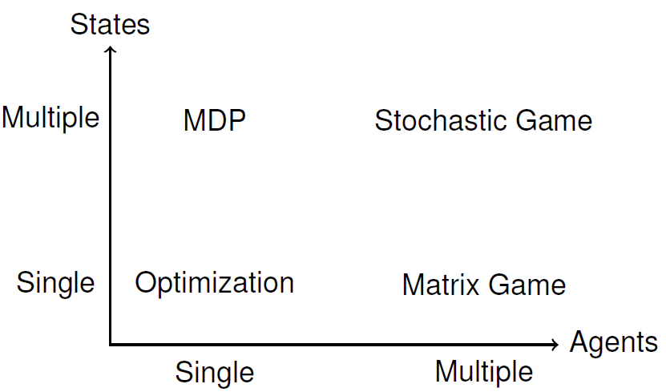
Multi-Agent RL (MARL)
Many practical applications involve multiple agents
Robotics, autonomous vehicles
Sensor networks
Video games, game of Go
Settings:
Cooperative
Non-cooperative
Mixed of the two
Algorithms:
Tabular case/linear function approximation, with convergence guarantee
Neural-nets for function approximation, mostly purely empirical
RL
MARL
Notes:
Note that besides SG, some other settings may also be claimed to be MARL, e.g., repeated games, extensive games.

Slide 4
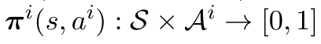
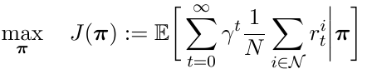
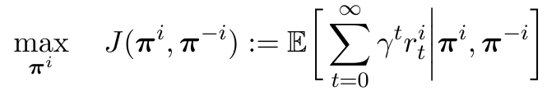
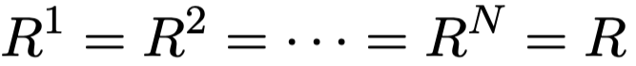
Challenges and Related Work
Challenges:
Non-stationarity [Tan ’93]
Curse of dimensionality: with # of agents
Related work (by settings):
Cooperative:
Multi-agent MDP [Boutilier ’02; Kar et al. ’13; Foerster et al. ’17; Zhang et al. ’18, ’19] :
Model: ,
Policy: , joint policy
Goal:
Team (common reward) stochastic game (SG) [Tan ’93; Wang et al. ’02; Foerster et al., ’16; Gupta et al., ’17; Arslan ’17]:
Same as above except: , and
Learning goal not clear [Shoham et al. ’06]
Notes:
Non stationarity due to the interaction between both the environment and the agents
Learning goal: equilibrium? What kind of equilibrium, why Nash? What about regret minimization? Why convergence? Is non-convergent behavior always bad? Should we focus on the convergence or the payoff the agents obtain? Is the learning procedure rational for each agent? How to learn?
Sum up: what’s the problem and the associated evaluation criteria

Slide 5
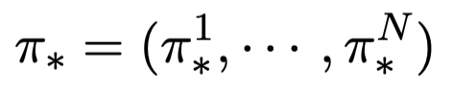
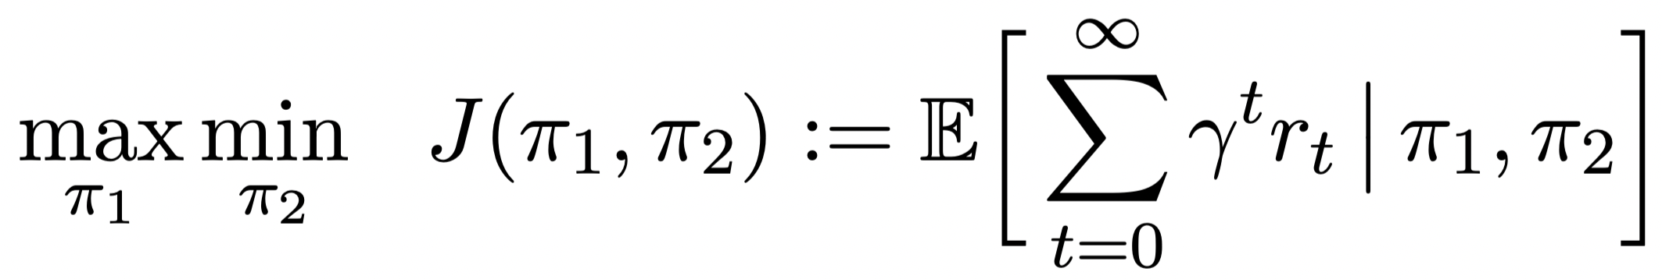
Related Work
Related work (by settings):
Non-cooperative:
General: general-sum SG
Model: , ,
Policy: , , joint policy
Goal:
Solution concept: Nash equilibrium
Fully competitive: zero-sum SG
Goal:

Slide 6
Related Work
Related work (by settings):
Mixed of the two [Lowe et al., ’17; Zhang et al., ’18; OpenAI 5v5 Dota, ’18]
E.g., two-team racing

Slide 7
Related Work
Related work (by algorithms):
Theoretical results:
Cooperative: independent Q learning (IQL) [Tan ’93], decentralized Q [Kar et al., ’13], decentralized actor-critic [Zhang et al., ’18,’19]
Non-cooperative: Minimax-Q [Littman ’94], Nash-Q [Hu et al. ’00], Friend-Foe-Q [Littman ’01], actor-critic for general-sum SG [Perolat et al. ’16], policy gradient (PG)-based learning [Mazumdar et al., ’18 ’19; Jin et al., ’19; Zhang et al., ’19]
Mixed: factorized LSPI [Lagoudakis & Parr ’03], decentralized fitted Q-iteration [Zhang et al., ’18]
Empirical results (with deep NN):
Cooperative: deep IQL [Tampuu et al., ’15] and variants [Foerster et al., ’16,’17], learning to communicate [Foerster et al., ’16], variants for partially-observed (PO) setting [Gupta et al., ’17]
Non-cooperative: opponent modeling +DQN [He et al., ’16], Learning with opponent-learning awareness (LOLA) [Foerster et al., ’18], PG-based robust adversarial RL (RARL) [Pinto et al. ’17],
Mixed: centralized critic + decentralized actor [Lowe et al., ’17], a unified game-theoretic framework for PO setting [Lanctot et al., ’18]
Notes:
Non stationarity due to the interaction between both the environment and the agents
Learning goal: equilibrium? What kind of equilibrium, why Nash? What about regret minimization? Why convergence? Is non-convergent behavior always bad? Should we focus on the convergence or the payoff the agents obtain? Is the learning procedure rational for each agent? How to learn?
Sum up: what’s the problem and the associated evaluation criteria

Slide 8
Other Open Problems in MARL
Theory for MARL with function approximation
Why FA: state-action spaces grow exponentially with # of agents
Naïve policy gradient fails to converge [Mazumdar et al. ’19, Jin et al. ’19]
Partially observable setting: decentralized POMDP (Dec-POMDP)
Much more practical
But most existing algorithms are either not scalable or lack of theory
Safe/Robust MARL
Robots, UVAs, self-driving fleets are safety-critical systems
Incorporate current safe RL results into the multi-agent setting
Model-based MARL

Slide 9
Multi-Car Racing (Ongoing)
Modeling:
Baseline setting: Consider fixed-policy opponent as part of the environment
General-sum stochastic game that penalizes collision in the objective
Zero-sum stochastic game with collision-avoidance constraints
Algorithms:
Infer opponent’s policy + PPO
PPO for general-sum SG
Constrained policy opt. (CPO) [Achiam et al., ’17] for zero-sum SG
Science innovation:
CPO for zero-sum SG
Special problems in DeepRacer: Robustness to the uncertainty of Reward
Model-based MARL?

Slide 10
Fully Decentralized Multi-agent Reinforcement Learning with Networked Agents
Kaiqing Zhang, Zhuoran Yang, Han Liu, Tong Zhang, and Tamer Basar, “Fully decentralized multi-agent reinforcement learning with networked agents,” in International Conference on Machine Learning (ICML), Stockholm, Sweden, 2018, pp. 5872–5881.

Slide 11
Overview
Background
Modeling
Algorithms
Theoretical Results
Simulations
Conclusions

Slide 12
Overview
Background
Modeling
Algorithms
Theoretical Results
Simulations
Conclusions

Slide 13
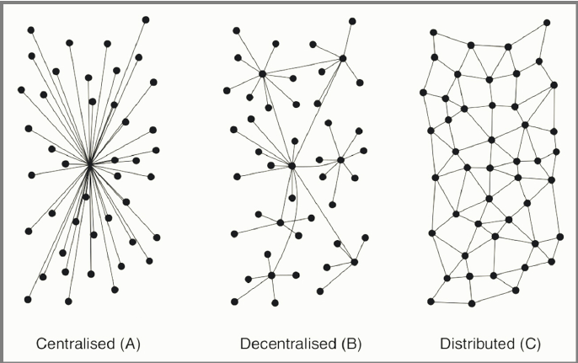
Decentralized Multi-agent Systems
Multi-agent systems (MAS) are ubiquitous
Centralized protocol v.s. Decentralized protocol
Central controller may not exists in many MAS applications
Advantages: i) resilient to attacks; ii) scalable; iii) privacy-preserving
Robotics
Smart Grid
Unmanned Aerial Vehicles
MOBA Video Games
Notes:
Robotics: Motion planning or navigation /territory exploration; robocup
The benefit of decentralized: 1. may not exist central controller; 2.resillient to malicious attacks; 3. increase the scalability when adding new agents; 4. preserve the privacy.

Slide 14
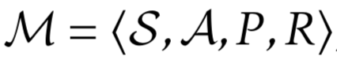
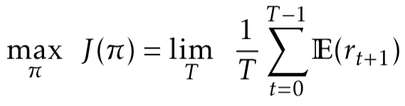
Reinforcement Learning (RL)
Markov decision process (MDP):
Goal: maximize time-average reward
Actor-critic algorithm
 | Pros. | Cons.
Value-based | Easy to implement | Can diverge with function approx.; can hardly handle continuous actions
Policy-based | Allow continuous action and stochastic policy; conv. guarantee with FA | Large variance of gradient estimate
Source: Reinforcement learning Lecture Notes, David Silver, 2016

Slide 15
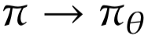
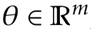
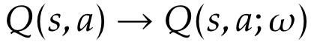
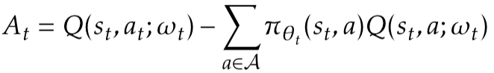
Actor-critic Algorithm
Parametrized policy with parameter
Basis: Policy Gradient Theorem [Sutton et. al. ’00]
Critic: policy evaluation with function approximation
Actor: policy improvement
baseline
Average running reward
Temporal difference (TD) error
TD update
Advantage function
Policy gradient update
Notes:
Stress the two-time scale and the empirical success in current works

Slide 16
Overview
Background
Modeling
Algorithms
Theoretical Results
Simulations
Conclusions

Slide 17
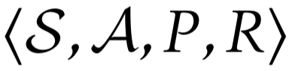
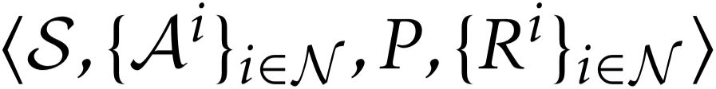
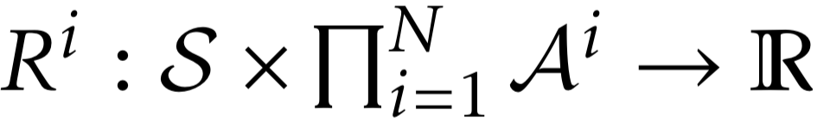
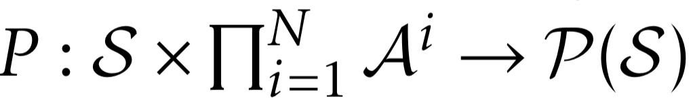
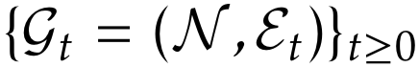
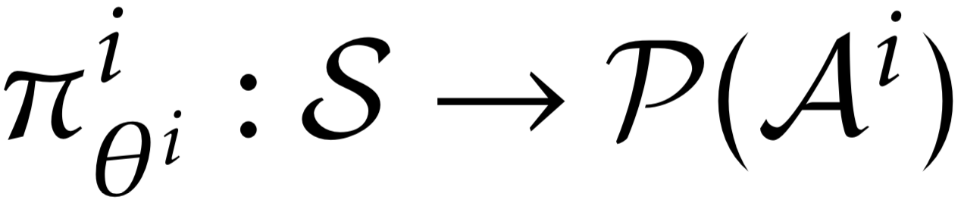
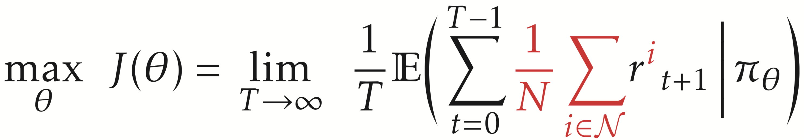
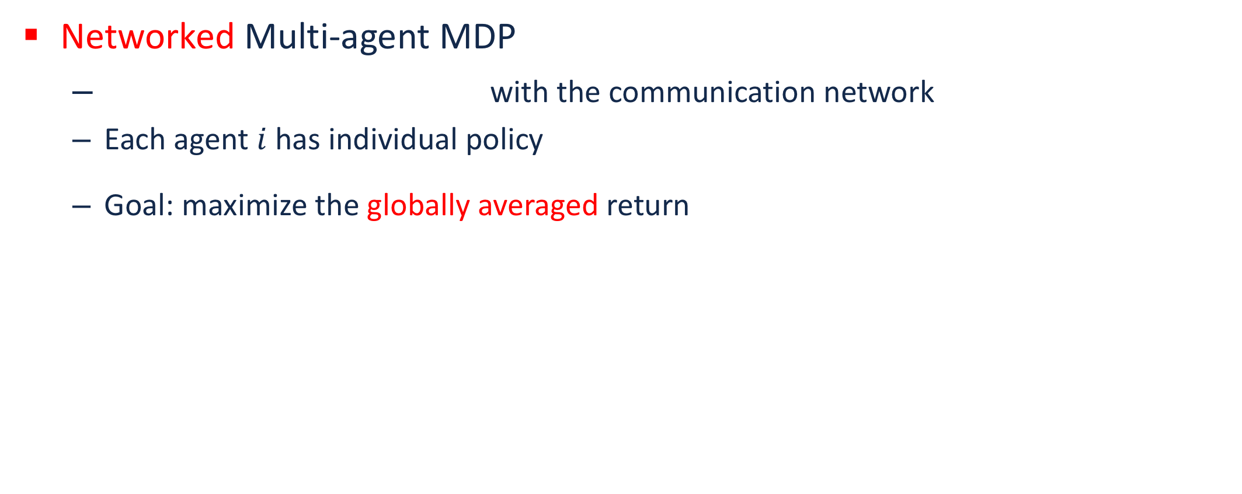
Collaborative Multi-agent RL
Multiple agents operate in a common environment
Our focus: fully decentralized setting
No central controller exists to coordinate
A fully decentralized network with heterogeneous agents
Both information and control are local
Networked Multi-agent MDP
with the communication network
Each agent $i$ has individual policy
Goal: maximize the globally averaged return

Slide 18
Related Work (Selected)
Multi-agent MDP [Boutilier ’02] and team Markov games [Wang et al., ’03][Arslan et al, 17’]: common reward function
Deep MARL [Lowe et al., ’17][Foerster et al. ’17][Gupta et al., ’17]: centralized critic or common reward
Multi-task RL [Wilson et al., ’07][Teh et al., ’17]: independent MDPs
A3C [Mnih et. al, ’16] and parallel computation/concurrent learning in RL: independent copies of one MDP
Most relevant: QD-Learning [Kar and Poor, ’13], however
Need a remote/global controller for action execution
Only consider the tabular setting with Q-learning
Notes:
In the multi-task examples, for the second one, they also have multiple workers, but they are in face of different but relevant MDPs, which are independent of each other

Slide 19
Overview
Background
Modeling
Algorithms
Theoretical Results
Simulations
Conclusions

Slide 20
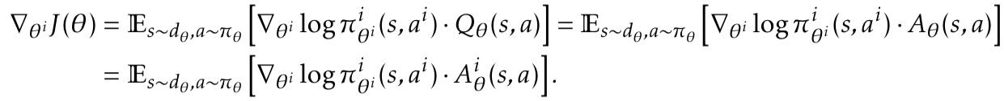
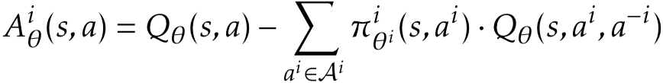
Algorithms
Multi-agent actor-critic algorithms
Fully decentralized update (only local information exchange allowed)
Using function approximation
Ideally, having theoretical convergence guarantees
Policy Gradient Theorem for MARL
where
For local policy improvement, a consensual estimate of global Q/advantage function is needed
Counterfactual baseline [Foerster et al., ’18][Wu et al., ’18]

Slide 21
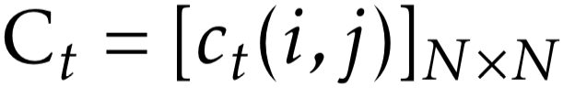
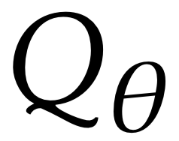
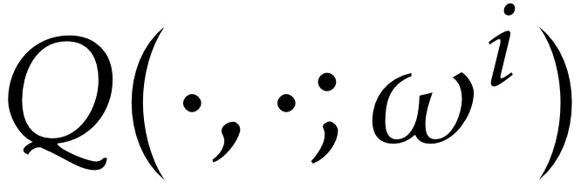
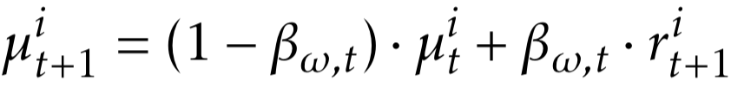
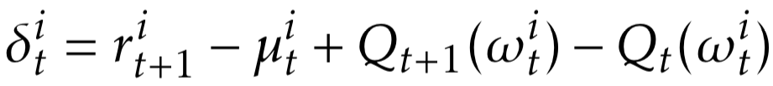
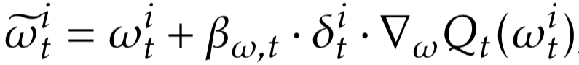
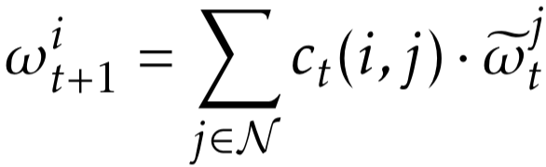
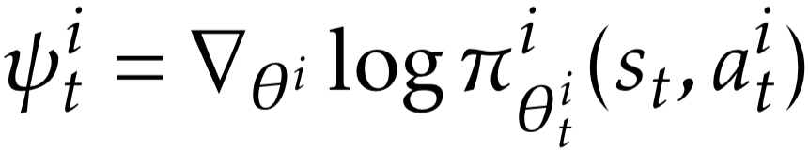
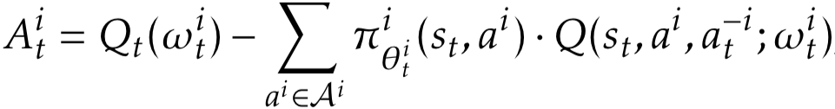
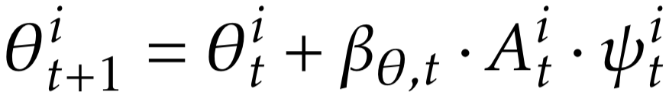
Algorithms
Consensus-based critic step:
Algorithm 1: Q function-based
Critic-step:
Actor-step:
weight
Local TD update
Consensus update
Estimated advantage function
Local policy gradient

Slide 22
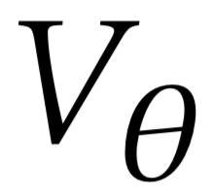
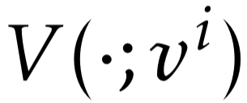
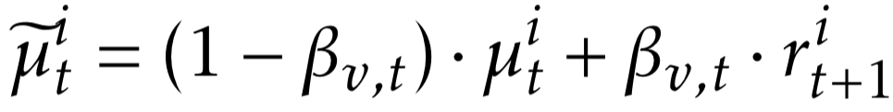
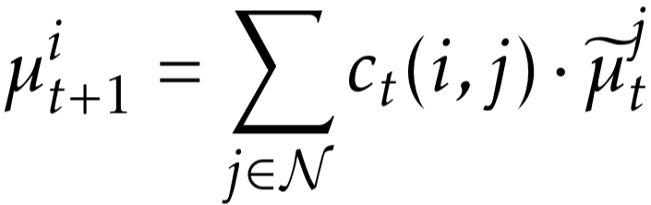
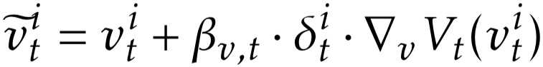
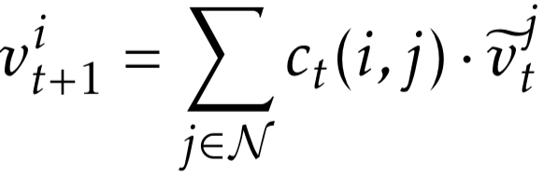
Algorithms
TD error unbiasedly estimates the advantage function
Algorithm 2: Value function-based
Critic-step:
Local TD update
Consensus update

Slide 23
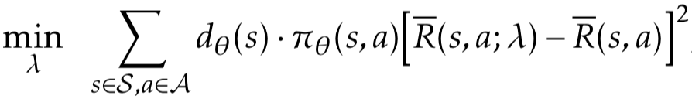
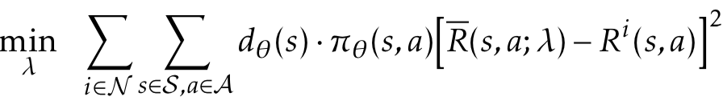
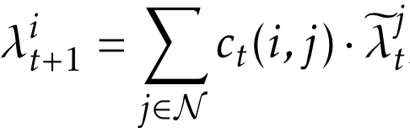
Algorithms
TD error unbiasedly estimates the advantage function
Algorithm 2: Value function-based
Need to estimate by
Critic-step (cont’d):
Globally averaged reward
Separable objective

Slide 24
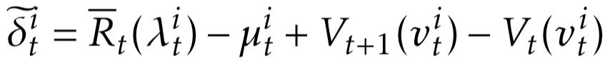
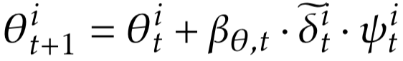
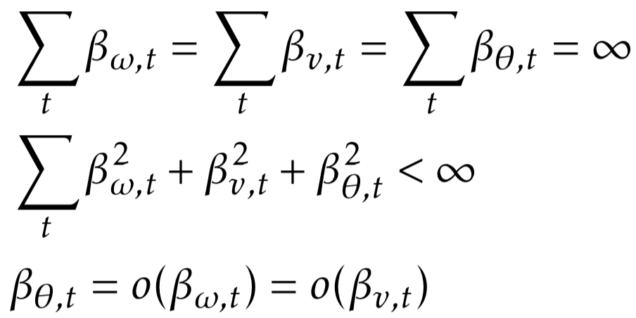
Algorithms
Algorithm 2: Value function-based
Actor-step:
Two time-scales:
Estimated globally averaged reward
Local policy gradient

Slide 25
Overview
Background
Modeling
Algorithms
Theoretical Results
Simulations
Conclusions

Slide 26
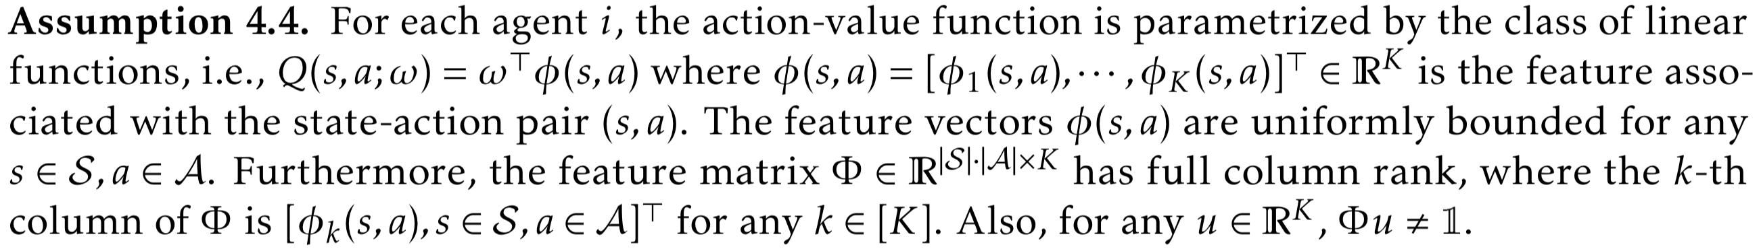
Assumptions
Regularity conditions for MDP [Bhatnagar et al. ’09]
Policy parameter set [Bhatnagar et al. ’09]
Linear function approximation [Tsitsiklis & Van Roy, ’99]

Slide 27
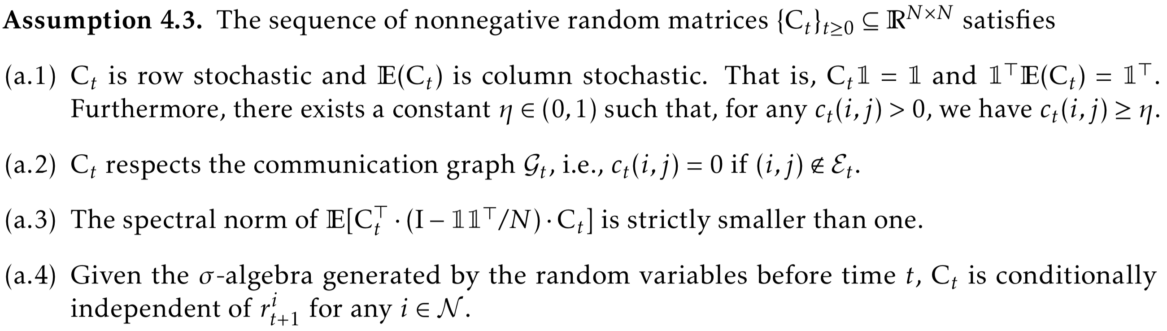




Assumptions
Consensus weight
Define projected-gradient operator :
Bellman operators:

Slide 28

Convergence Results
Algorithm 1
Critic-step
The same fixed-point that single-agent critic step converges to

Slide 29


Convergence Results
Algorithm 1
Actor-step
Algorithm 2
Critic-step
The best convergence result can hope for even for single-agent actor-critic

Slide 30

Convergence Results
Algorithm 2
Actor-step

Slide 31

Technical Remarks
Basic technique: two-timescale stochastic approximation [Borkar, ’08]
Critic-step: most existing proof techniques on distributed/consensus optimization do not apply
TD update is not a stochastic gradient
of a fixed and well-defined function
Noises are correlated in online RL algorithms
As a byproduct, we have also proved the stability, i.e., almost sure boundedness, of this consensus stochastic sequence
The same type of convergence guarantees as single-agent actor-critic

Slide 32
Overview
Background
Modeling
Algorithms
Theoretical Results
Simulations
Conclusions

Slide 33



Linear Function Approximation
Randomly generated MDP + linear function approximation
Fig. Convergence of value functions
Fig. Convergence of globally averaged returns
Fig. Policies the algorithms converge to

Slide 34


Nonlinear Function Approximation
MARL task: Cooperative navigation problem [Lowe et al., ’17]
Using 3-layer neural nets for function approximation
Fig. cooperative navigation problem
Fig. Comparison between the decentralized algorithms and their centralized counterparts
Fig. Comparison between the cooperative algorithms (centralized & decentralized) and the non-cooperative ones

Slide 35
Overview
Background
Modeling
Algorithms
Theoretical Results
Simulations
Conclusions

Slide 36
Conclusions
We proposed a fully decentralized multi-agent reinforcement learning model with networked agents
We developed the first decentralized online actor-critic algorithms with function approximation, which only rely on neighbor-to-neighbor communications
We proved the convergence of the algorithms with linear function approximation, and corroborated the results via simulations
Future work
The mixed setting with both collaborative and competitive agents over the network
Improve the convergence guarantee for (MARL) actor-critic algorithms
Finite-sample analyses for MARL

Slide 37
References
M. L. Littman. “Markov games as a framework for multi-agent reinforcement learning,” In Machine learning proceedings, pages 157–163. Elsevier, 1994.
C. Boutilier. “Planning, learning and coordination in multi-agent decision processes,” In Conference on Theoretical Aspects of Rationality and Knowledge, pages 195–210, 1996.
M. L. Littman. “Friend-or-foe Q-learning in general-sum games,” In International Conference on Machine Learning, volume 1, pages 322–328, 2001.
Y. Shoham, R. Powers, and T. Grenager. “Multi-agent reinforcement learning: A critical survey,” Technical Report, 2003.
X. Wang and T. Sandholm. “Reinforcement learning to play an optimal Nash equilibrium in team Markov games,” In Advances in Neural Information Processing Systems, pages 1603–1610, 2003.
J. Hu and M.P. Wellman. “Nash Q-learning for general-sum stochastic games,” Journal of Machine Learning Research, 4(11):1039–1069, 2003.
T. Smith and R. Simmons. “Heuristic search value iteration for POMDPs,” In Proceedings of the Conference on Uncertainty in Artificial Intelligence, pages 520–527, 2004.
D. Silver and J. Veness. “Monte-Carlo planning in large POMDPs,” In Advances in Neural Information Processing Systems, pages 2164–2172, 2010.
S. Kar, J.M. Moura, and H.V. Poor. “QD-learning: A collaborative distributed strategy for multi-agent reinforcement learning through consensus + innovations,” IEEE Transactions on Signal Processing, 61(7):1848–1862, 2013.
J. Foerster, Y.M. Assael, N. Freitas, and S. Whiteson. “Learning to communicate with deep multi-agent reinforcement learning,” In Advances in Neural Information Processing Systems, pages 2137–2145, 2016.

Slide 38
References
J. Perolat, F. Strub, B. Piot, and O. Pietquin. “Learning Nash equilibrium for general-sum Markov games from batch data.,” arXiv preprint arXiv:1606.08718, 2016.
R. Lowe, Y. Wu, A. Tamar, J. Harb, P. Abbeel, and I. Mordatch. “Multi-agent actor-critic for mixed cooperative competitive environments,” arXiv preprint arXiv:1706.02275, 2017.
G. Arslan and S. Yüksel, “Decentralized Q-learning for stochastic teams and games,” IEEE Transactions on Automatic Control, vol. 62, no. 4, pp. 1545–1558, 2017.
A. Mathkar and V. S. Borkar. “Distributed reinforcement learning via gossip,” IEEE Transactions on Automatic Control , 62(3):1465–1470, 2017.
K. Zhang, Z. Yang, H. Liu, T. Zhang, and T. Başar. “Fully decentralized multi-agent reinforcement learning with networked agents,” In International Conference on Machine Learning, pages 5872–5881, 2018.
K. Zhang, Z. Yang, and T. Başar. “Networked multi-agent reinforcement learning in continuous spaces,” In Proceedings of IEEE Conference on Decision and Control, pages 2771–2776. IEEE, 2018.
K. Zhang, Z. Yang, H. Liu, T. Zhang, and T. Başar. “Finite-sample analyses for fully decentralized multi-agent reinforcement learning,” arXiv preprint arXiv:1812.02783, 2018.
L. Lin, K. Zhang, Z. Yang, Z. Wang, T. Başar, R. Sandhu, and J. Liu. “A Communication-Efficient Multi-Agent Actor-Critic Algorithm for Distributed Reinforcement Learning,” submitted to Proceedings of IEEE Conference on Decision and Control, IEEE, 2019.
J. K. Gupta, M. Egorov, and M. Kochenderfer. “Cooperative multi- agent control using deep reinforcement learning,” In International Conference on Autonomous Agents and Multiagent Systems, pages 66–83. Springer, 2017.

Slide 39
References
E. V. Mazumdar, M. I Jordan, and S. S. Sastry. “On the convergence of gradient-based learning in continuous games,” arXiv preprint arXiv:1804.05464, 2018.
E. V. Mazumdar, M. I Jordan, and S. S. Sastry. “On finding local Nash equilibria (and only local Nash equilibria) in zero-sum games,” arXiv preprint arXiv:1901.00838, 2019.
C. Jin, P. Netrapalli, and M. I Jordan. “Minmax optimization: Stable limit points of gradient descent ascent are locally optimal,” arXiv preprint arXiv:1902.00618, 2019.
K. Zhang, Z. Yang, and T. Başar. “Policy optimization provably converges to Nash equilibria in zero-sum linear quadratic games,” arXiv preprint arXiv:1906.00729, 2019.
H. He, J. Boyd-Graber, K. Kwok, and H. Daumé III. “Opponent modeling in deep reinforcement learning,” In International Conference on Machine Learning, pages 1804–1813, 2016.
M. Lanctot, V. Zambaldi, A. Gruslys, A. Lazaridou, K. Tuyls, J. Perolat, D. Silver, and T Graepel. 2017. “A unified game theoretic approach to multiagent reinforcement learning.” In Advances in Neural Information Processing Systems pages 1603–1610, 2018.

Slide 40
Thank You!

Slide 41
Back up slides

Slide 42
Our work: Decentralized MARL¹
Collaborative multi-agent systems (MAS) are ubiquitous
Centralized protocol v.s. Decentralized protocol
Central controller may not exists in many MAS applications
Advantages: i) resilient to attacks; ii) scalable; iii) privacy-preserving
Robotics
Smart Grid
Unmanned Aerial Vehicles
MOBA Video Games
¹K. Zhang, Z. Yang, H. Liu, T. Zhang, and T. Başar, “Fully decentralized multi-agent reinforcement learning with networked agents,” in ICML, 2018, pp. 5872– 5881.
Notes:
Robotics: Motion planning or navigation /territory exploration; robocup
The benefit of decentralized: 1. may not exist central controller; 2.resillient to malicious attacks; 3. increase the scalability when adding new agents; 4. preserve the privacy.

Slide 43

Our work: Decentralized MARL
Setting: Networked Multi-agent MDP
with the communication network
Each agent $i$ has individual policy
Goal: maximize the globally averaged return
Algorithm: multi-agent actor-critic
Fully decentralized update
Using function approximation to handle large state-action spaces
Should have theoretical convergence guarantees
A fully decentralized network with heterogeneous agents

Slide 44
Our work: Decentralized MARL
Policy Gradient Theorem for Multi-agent MDP
where
Decentralized multi-agent actor-critic
Critic-step:
Actor-step:
Local temporal difference (TD) update
Local policy gradient
Consensus update

Slide 45
Our work: Decentralized MARL
Guaranteed to converge asymptotically with linear function approx.
Empirically also works for neural nets function approx.
Fig. Convergence of globally averaged returns
Fig. Policies the algorithms converge to
Comparison between the decentralized and centralized algorithms
cooperative navigation problem

Slide 46
Our other (ongoing) work on MARL
Extend previous MARL to continuous space [Zhang et al. ’ CDC 2018]
Finite-sample analyses for batch decentralized MARL [Zhang et al. ’ 18]
Convergence results above are only asymptotic, no finite-sample performance
Mixed setting: we considered the same networked MDP setting as before, plus a two-team setting where each team is a networked MDP
Algorithm: fitted-Q iteration that can be implemented in a decentralized way
Results: quantified how the Q-function estimation error depends on
# of samples and # of iterations
Error caused by decentralized computation
Expressiveness of the function class for Q-function approx.

Slide 47

Our other (ongoing) work on MARL
Communication-efficient MARL [Chen et al. ’18][Lin et al. ’19]
[Chen et al. ’18]: MARL policy gradient method, but agents only transmit the local gradients occasionally by checking certain conditions
RL for linear quadratic zero-sum games
Policy gradient methods for Nash-equilibrium seeking, with finite-sample convergence guarantees
Possibly applied for $H_{∞}$ and risk-sensitive optimal control
[Lin et al. ’19]: actor-critic as before, but only randomly transmit one entry in each consensus step

Slide 48

Other MARL Algorithms
Evolutionary game theory-based MARL
Cross-learning [Cross ’73], FAQ/Lenient FAQ-learning [Kaisers ’10], replicator dynamics [Tuyls ’09]: for stateless MG only
Piecewise replicator dynamics [Vrancx et al. ’08], Learning automata [Vrancx et al. ’08]: for MG

Slide 49
Other MARL Algorithms
Early work without convergence guarantees
General-sum Markov games: WoLF-PHC [Bowling et al. ’02], policy gradient [Kononen ’04]: policy search-based; PD-WoLF [Banerjee et al. ’03], EXORL [Suematsu et al. ’03], R-MAX [Brafman et al. ’03], etc.

Slide 50
Technical Remarks for our MA actor-critic
Basic technique: two-timescale stochastic approximation [Borkar, ’08]
Critic-step: most existing proof techniques on distributed/consensus optimization do not apply
TD update is not a stochastic gradient
of a fixed and well-defined function
Noises are correlated in online RL algorithms
As a byproduct, we have also proved the stability, i.e., almost sure boundedness, of this consensus stochastic sequence
The same type of convergence guarantees as single-agent actor-critic

